Slide 1
Candy Hunting
Malik Ouda, Noah Placke, Mounika Tarigopula,
Sarah Teng, Timothy Wong
Notes:
Sarah - intro and project goals
Noah & Malik - Frequency analysis, sentiment analysis, NodeXL
Mounika - Google vision & engagement score calculations
Tim - Topic modeling

Slide 2
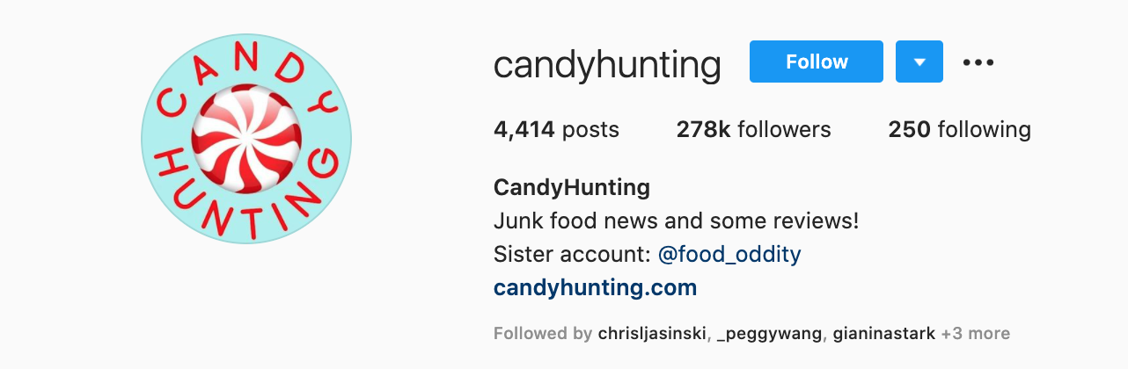
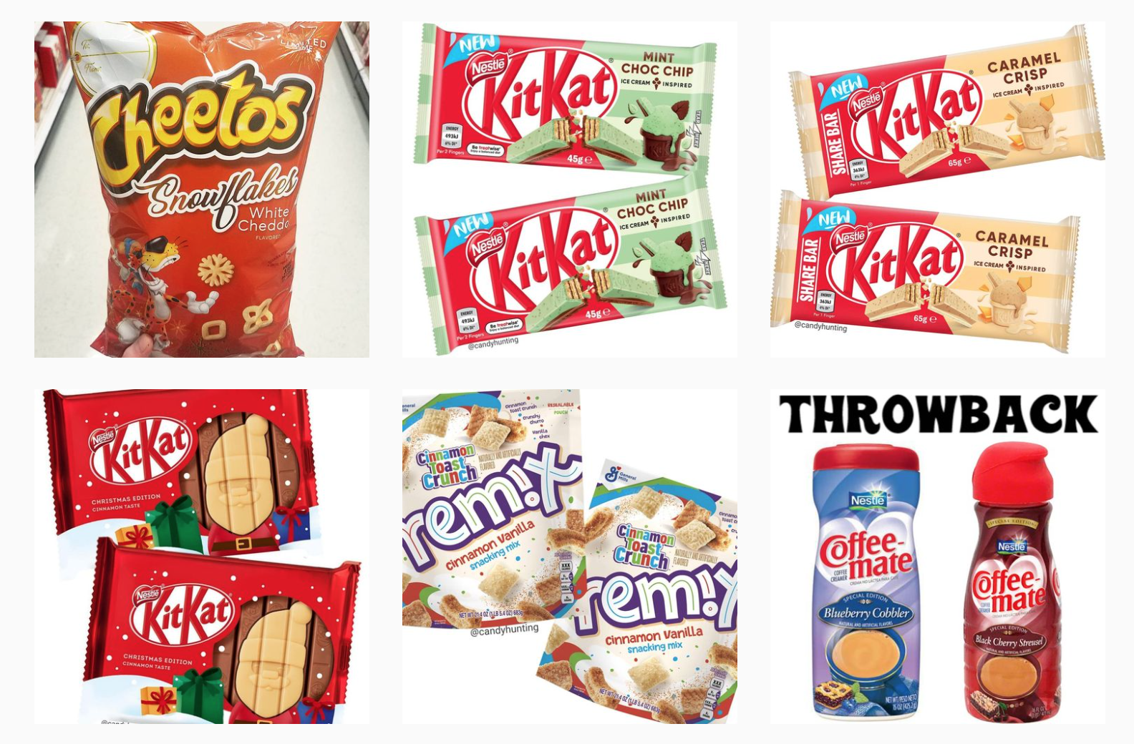
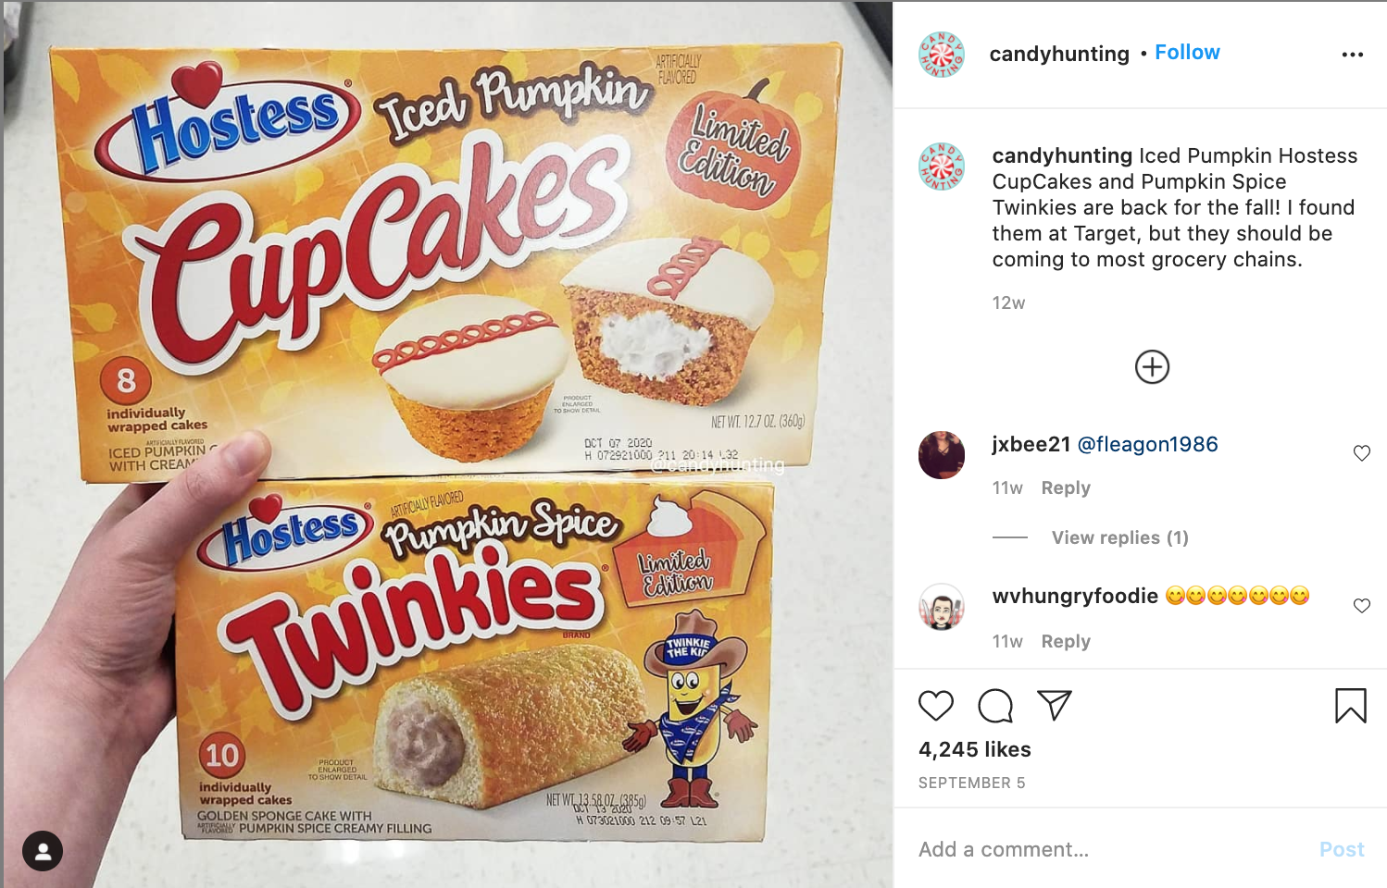
Candy Hunting

Slide 3
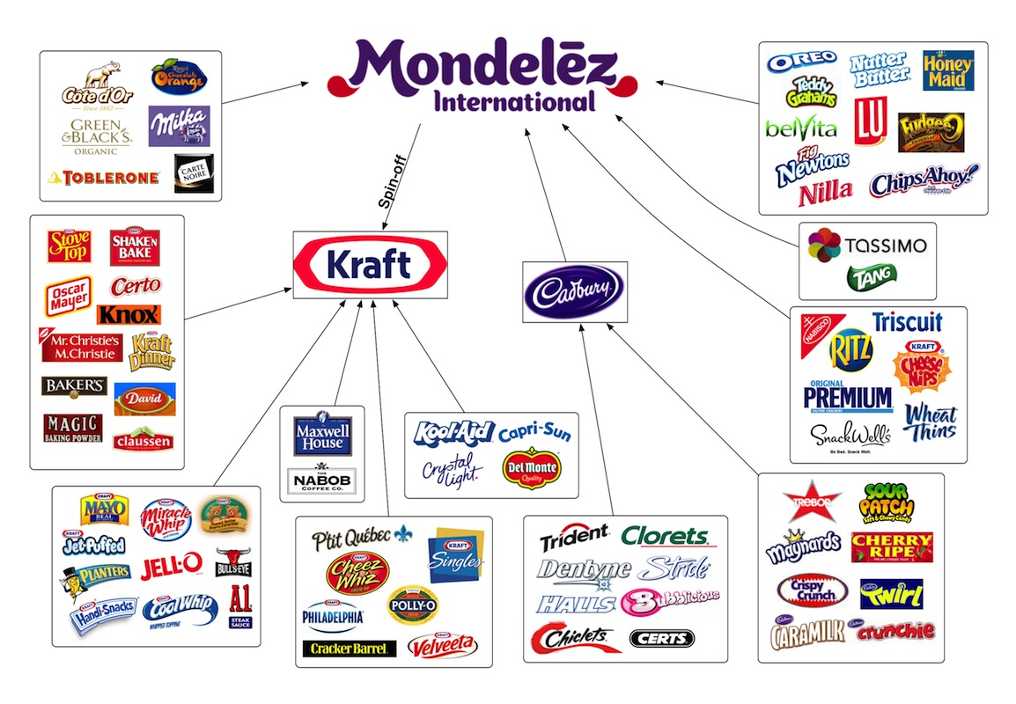
Mondelez International

Slide 4
Project Goals & Objectives
01
02
03
Snacks vs. Sweets
Flavors & Tastes
The Next New Product
Determine whether snacks or sweets (candy) are more popular using sentiment and engagement scores
Determine which flavors or tastes are popular based on frequency and sentiment analysis
Combined with the previous two objectives, make a recommendation for creating the next best snack/candy based on frequency analysis, sentiment analysis, and image analytics topic modeling

Slide 5
What snack or candy should Mondelez International produce next?
We will analyze trends, sentiments, and popular topics to find out!

Slide 6
Frequency/ Sentiment Analysis
and some NodeXL

Slide 7
Which Words Were Most Popular?
Word frequency was calculated using both the comments and captions for each post
From our word frequencies, we could see which adjectives were used the most among all posts
Along with single word counts, we calculated pair frequency to be used later with our sentiment analysis

Slide 8
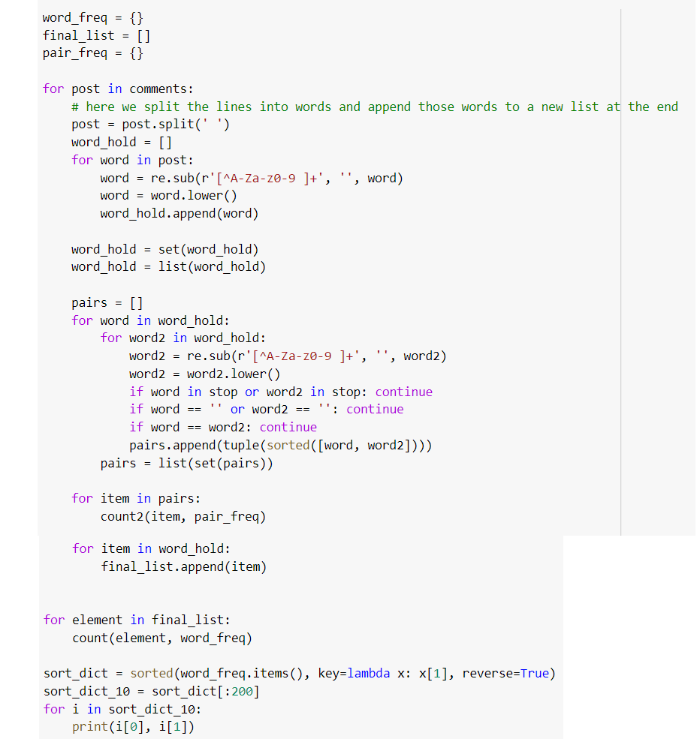
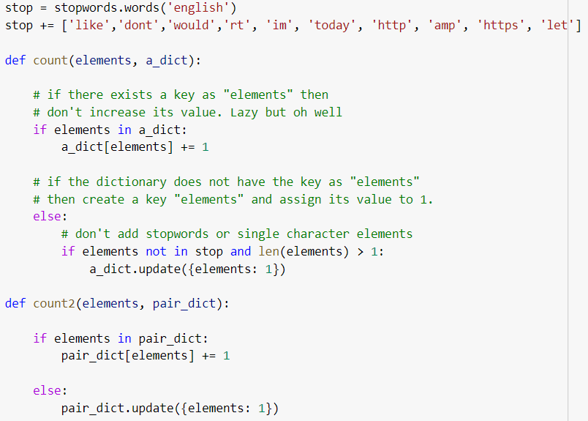
How We Counted Words

Slide 9
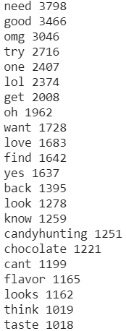
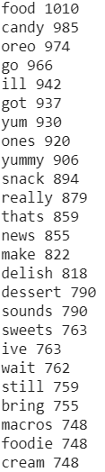
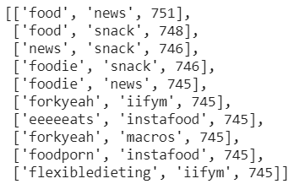
Examples of CandyHunting Words

Slide 10
Snack Foods vs. Candy Foods
We split the types of food seen on the @candyhunting IG page into two categories: Snacks and Candy
With these two types of categories, we were able to analyze engagement and sentiment towards snack foods and candy foods and see how they differed
In addition, we looked at several attributes of the posts, based on our word frequencies:
Flavor, Chocolate, Yummy, Sweets, Cream, Pumpkin, Coffee, Cinnamon, Caramel, Strawberry

Slide 11
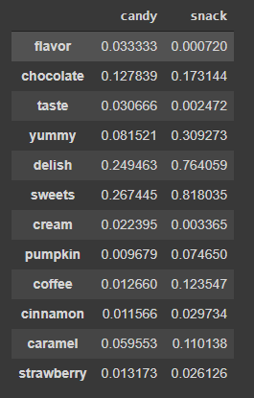
Candy and Snack Lifts
Our analysis showed, in general, a low lift value between our attributes and our categories. Some notable differences that we found were:
Snack foods actually had a higher association with chocolate than candy foods
Snacks had a much higher association with ‘yummy’ and ‘delish’ and ‘sweets’ than candies

Slide 12
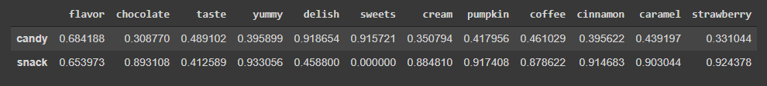
Do people like candy or snack foods more?
After doing a lift analysis to get a general sense of associations between the two categories, we did a sentiment analysis between each attribute and each category
We found that…
All intersections of category and attribute were positive, except for ‘snack’ and ‘sweets’ which had a neutral sentiment
The highest sentiment was between ‘yummy’ and ‘snack’
Snacks generally had higher sentiments than candy foods did
The most popular flavor of candies were coffee, caramel, and pumpkin
The most popular flavor of snacks were strawberry, cinnamon, and pumpkin

Slide 13
Interesting Anomalies in the Data
High presence of ‘pumpkin’ likely due to the proximity of Thanksgiving and Halloween to our data collection
The line between ‘snack’ and ‘candy’ is not very delineated (some people may call a food a snack while it may be more of a candy to others)
This can be seen by the higher sentiment of ‘chocolate’ with ‘snack’
No negative sentiments - a page dedicated to food is unsurprisingly a pretty positive place to visit

Slide 14
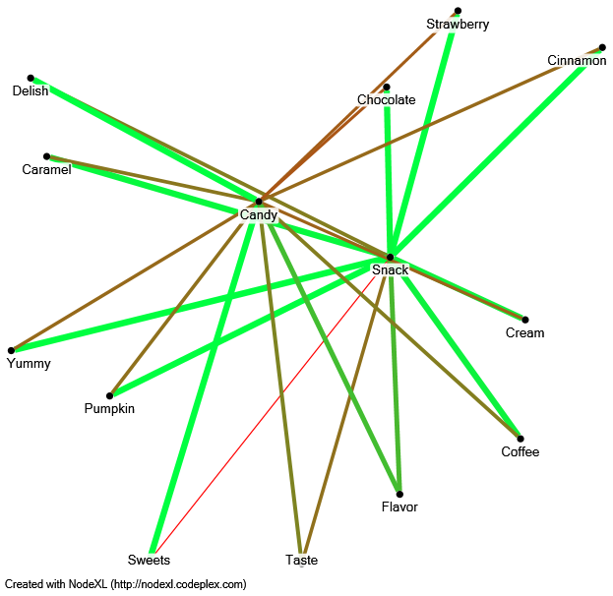
Sentiment Visualized with NodeXL

Slide 15
Google Vision
& Engagement Scores

Slide 16
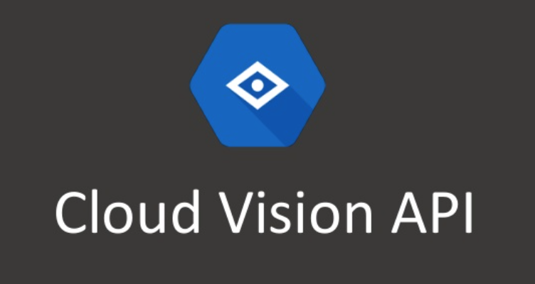
Google Vision
We used the cloud vision API to gather
labels
Object function detects the individual
objects and labels function predicts what the
entire image represents

Slide 17
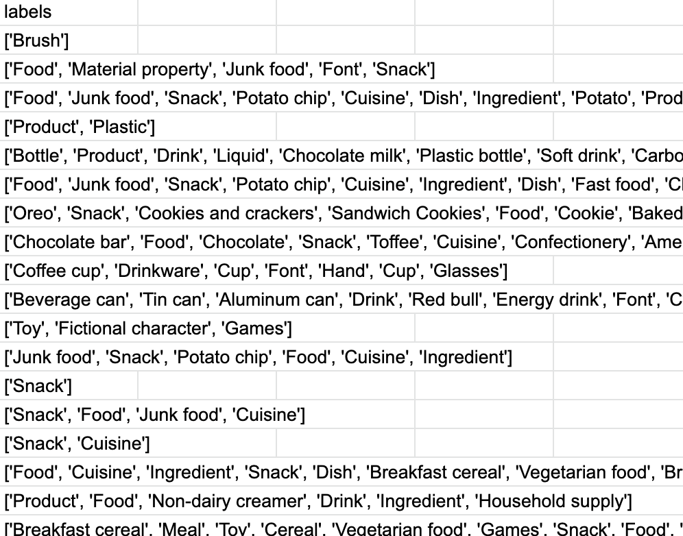
Examples of Labels

Slide 18
Engagement Metrics
We calculated an engagement score for each post
We compared whether the engagement score
was high or low based on the median engagement
Highest engagement topic:
Breakfast foods
Lowest engagement topic:
Frozen Foods
Engagement Score =
0.4*Likes + 0.6*Comments

Slide 19
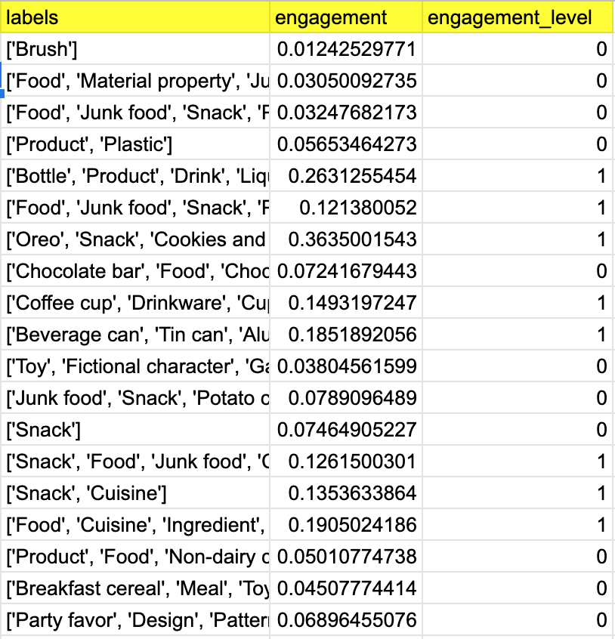
Example of Engagement Metrics

Slide 20
Topic Modeling &
Recommendations

Slide 21
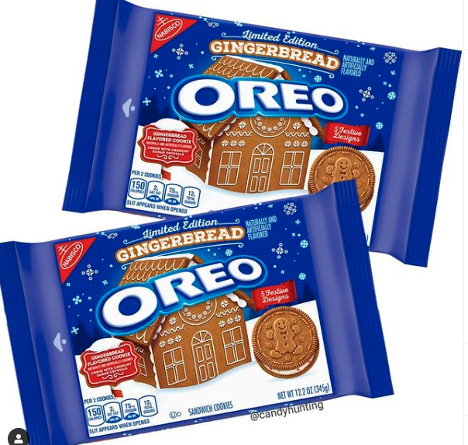
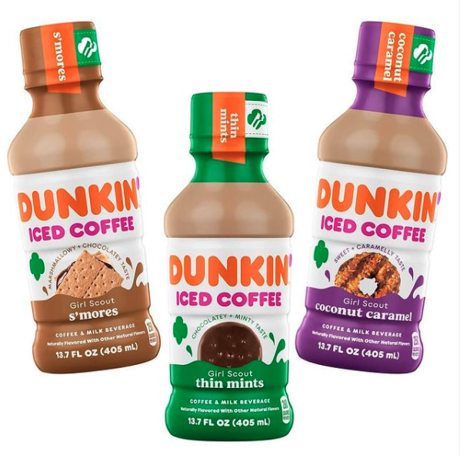
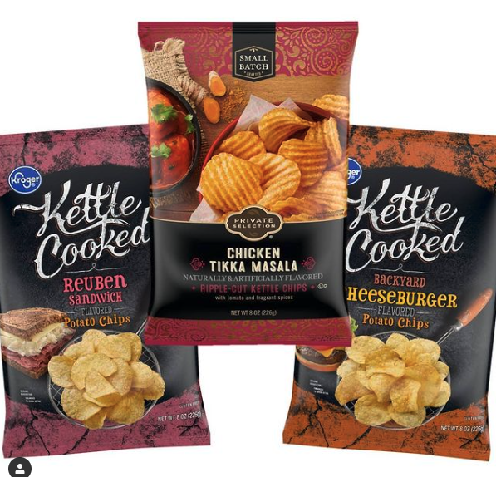
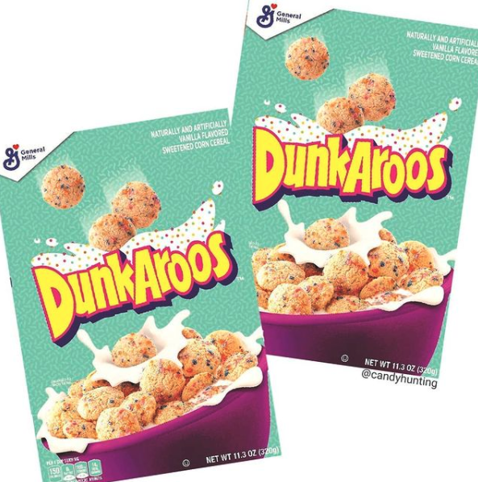
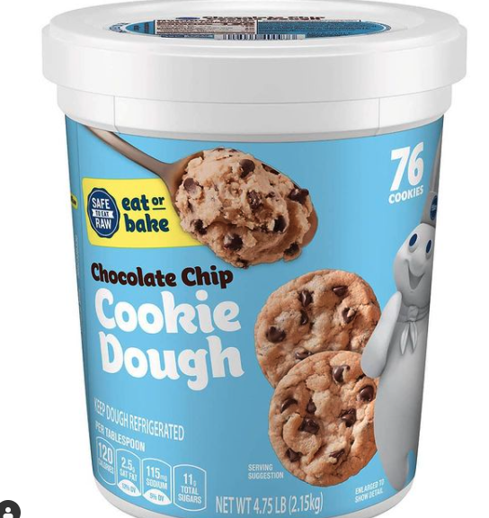
Topic Modeling
Beverages
Sweet Snacks
Salty Snacks
Breakfast
Dessert

Slide 22
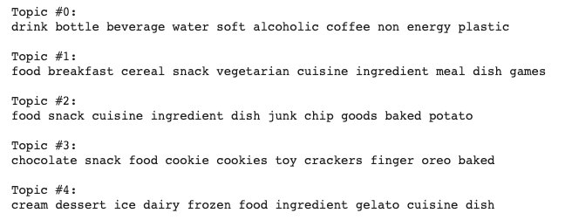
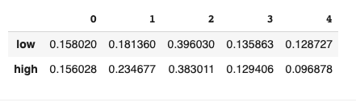
Topic Modeling
Our purpose of Topic modeling was to determine what type of foods instagram user talk about on the @CandyHunting page
Conducted Topic Modeling via LDA on our Image Labels from our Google Vision Analysis
Analyzed the lower 25th quartile and upper 75th quartile to identify differences in average topic weights

Slide 23
Conclusion & Recommendations
Frequency Analysis
Sentiment Analysis
High frequency words:
flavor
chocolate
cream
pumpkin
Highest sentiments:
snack-pumpkin
snack-cinnamon
snack-strawberry
coffee
cinnamon
caramel
strawberry
Engagement Scores
Topic Modeling
Highest engagement topic:
Breakfast foods
Lowest engagement topic:
Frozen desserts
Topics:
Drinks & beverages
Breakfast foods
Salty snacks
Sweet snacks
Frozen desserts

Slide 24
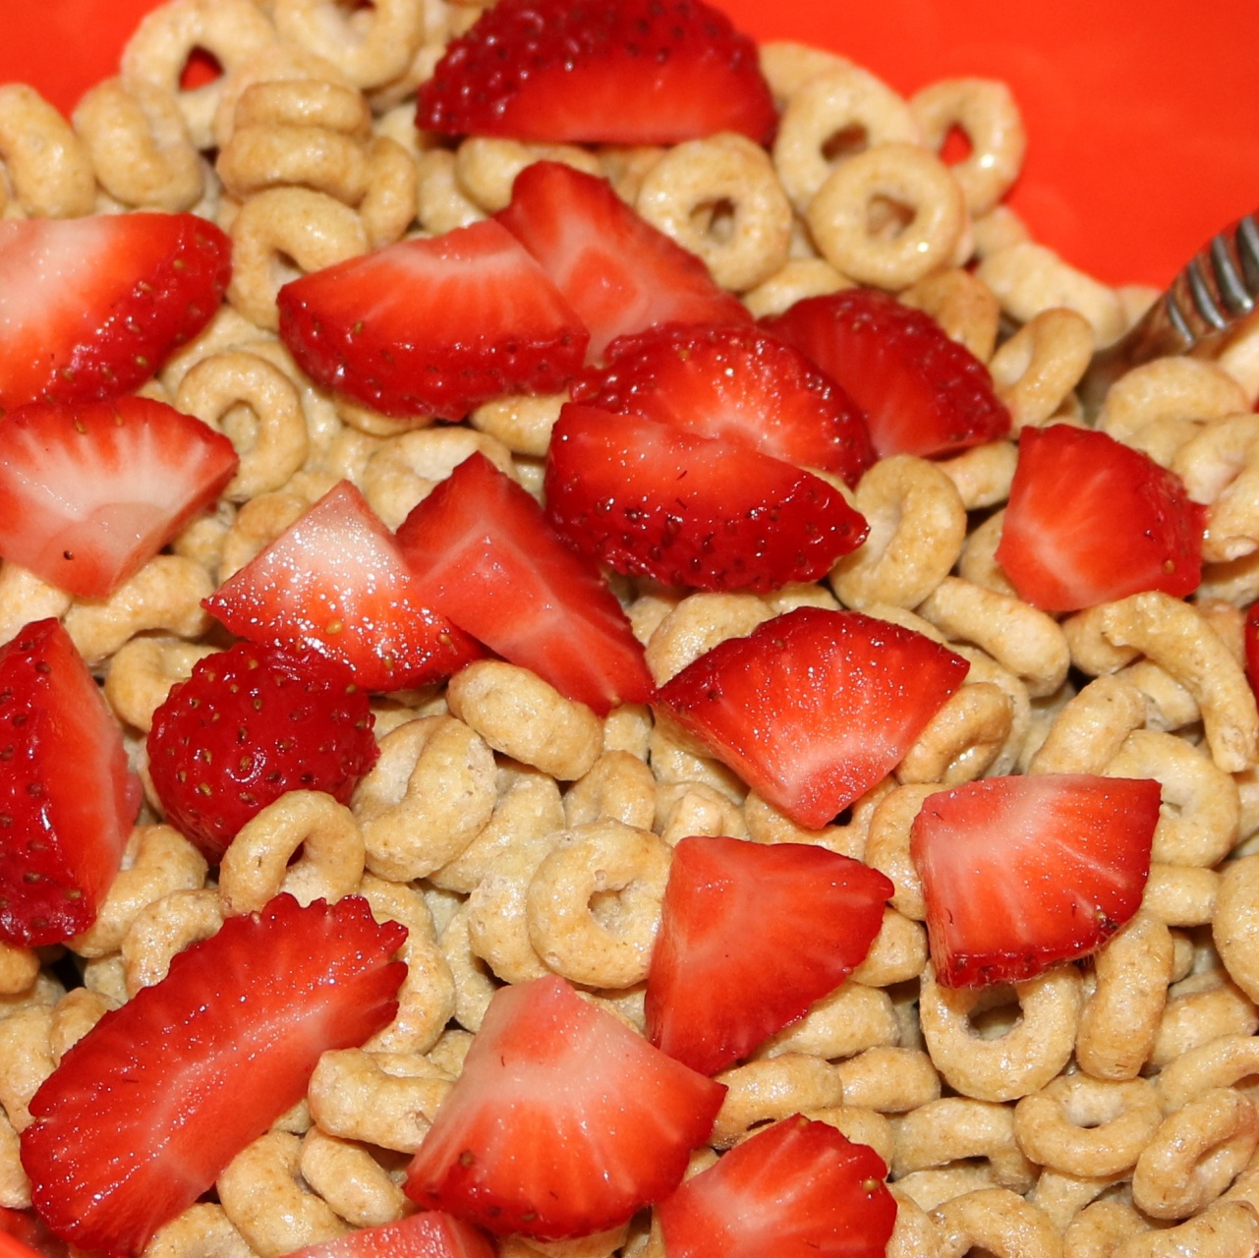
Our Recommendation: Strawberry Cereal
Based on the analyses performed and our findings on the previous slide, we recommend that Mondelez release a new strawberry flavored cereal.
Our sentiment analysis revealed that strawberry was the most positively associated flavor for snacks, and our image analysis revealed that breakfast foods/cereals were the most engaging photos posted on Candy Hunting’s Instagram feed.
Putting these conclusions together, we recommend that Mondelez International produce a strawberry cereal as their next product.

Slide 25
Thanks!
QUESTIONS?

